Slide 1
REVATHI.R
BE(CSE)
PANIMALAR INSITITUTE OF TECHNOLOGY

Slide 2
Traditional Methodologies - Overview
Definition: Traditional methodologies are structured project management and software development approaches, focusing on sequential steps.
Common Types:
Waterfall Model
V-Model
Iterative Model
Spiral Model
Main Focus: Detailed planning and documentation before starting execution.

Slide 3
Objectives of Traditional Methodologies
Clear, defined requirements before work starts.
Structured development process.
Early detection of design flaws.
Strong documentation at each phase.

Slide 4
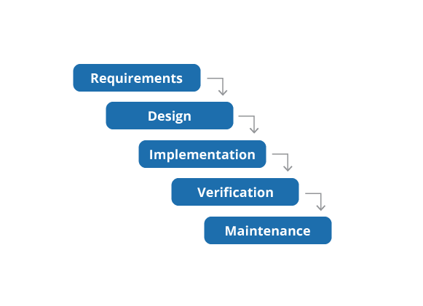
TYPES OF TRADITIONAL METHODOLOGIES WATERFALL MODEL:

Slide 5
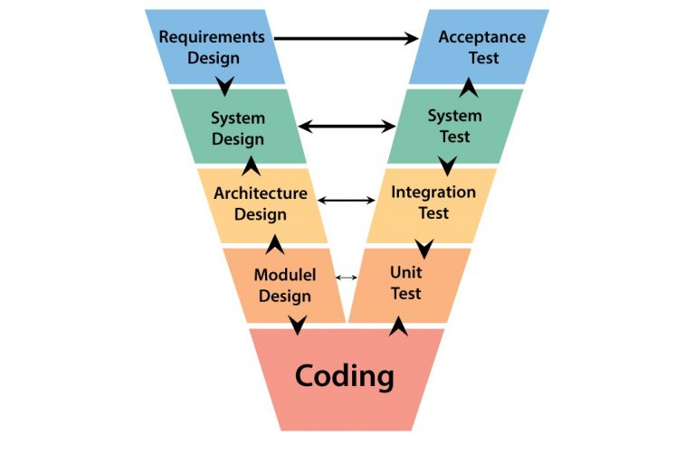
V MODEL:

Slide 6
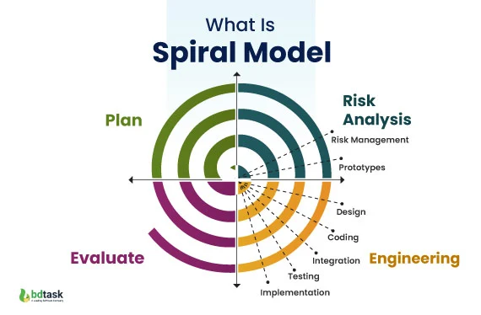
SPIRAL MODEL:

Slide 7
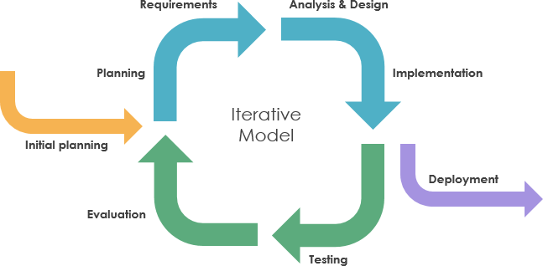
ITERATIVE MODEL:

Slide 8
Process of Traditional Methodologies
Steps:
1. Requirement Gathering
2. System Design
3. Implementation (Coding)
4. Testing
5. Deployment
6. Maintenance
Flow: Linear or structured sequence; move to next stage only after completion of the previous one.

Slide 9
ADVANTAGES AND DRAWBACKS
ADVANTAGES | DRAWBACKS
Easy to manage and control. | Inflexible to changes once process starts.
Clear milestones and deliverables. | Late testing may reveal major issues.
Well-suited for projects with fixed requirements. | Customer feedback comes late in the cycle.
 | Risk of misaligned end product if initial requirements are misunderstood.

Slide 10
agile Methodologies - Overview
Agile methodologies are a set of approaches to software development that emphasize flexibility, collaboration, customer feedback, and rapid delivery of small, working pieces of software.
Popular Agile frameworks:
Scrum
Kanban
Extreme Programming (XP)
Lean Development

Slide 11
Objectives of AGILE methodologies
Customer Satisfaction: Deliver valuable software early and continuously to meet customer needs.
Flexibility: Adapt quickly to changing requirements, even late in development.
Collaboration: Foster close, daily cooperation between business people and developers.
Working Software: Focus on delivering functional software frequently.

Slide 12
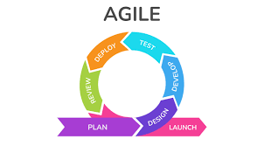
PROCESS OF AGILE METHODOLOGIES

Slide 13
ADVANTAGES AND DRAWBACKS
ADVANTAGES | DRAWBACKS
Flexibility: Easily adapts to changing requirements. | Less Predictability: Hard to predict timelines, costs, and resources exactly.
Faster Delivery: Working software is delivered frequently. | Requires Experienced Team: Needs skilled and self-disciplined members.
Customer Satisfaction: Continuous involvement keeps the customer happy. | Scope Creep Risk: Frequent changes may lead to uncontrolled scope expansion.
Improved Quality: Regular testing and feedback lead to better products. | Documentation Can Suffer: Focus on working software sometimes reduces proper documentation.

